Slide 1
Introduction to Power Electronics

Slide 2
What is Power Electronics?
—Power Electronics defined as the application of solid-state (devices)
electronics for the control and conversion of electric power.
—Power electronics have already found an important place in modern
technology and are now used in a great variety of high-power product,
including heat controls, light controls, electric motor control, power
supplies, vehicle propulsion system and high voltage direct current
(HVDC) systems.

Slide 3
Relation With Multiple Discipline:
Systems & control theory
Signal processing
Circuit theory
Power
Electronics
Simulation & computing
Electric machines
Electronics
Solid state physics
Power systems
Electromagnetics

Slide 4
The Inter- Disciplinary Nature:
Power Electronics
Continuous discrete
control
Electronics
Devices,
circuits
Power
Static & rotating power equipment

Slide 5
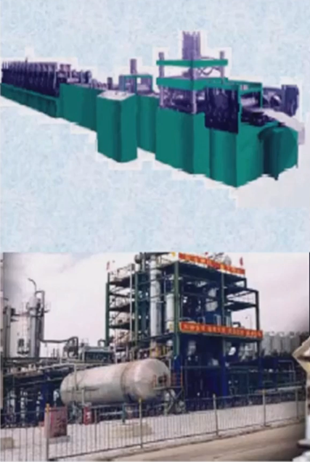
Applications
Motor drives
Electrolysis
Electroplating
Induction heating
Welding
Arc furnaces and ovens
Lighting

Slide 6
Power Electronic Switching Devices:
1.Uncontrolled turn on and off (Power Diode)
2.Controlled turn on uncontrolled turn off (Thyristors)
3.Controlled turn on and off characteristic (Power Transistor, BJT, MOSFET, GTO, IGBT)
4.Continuous gate signal requirement (BJT, MOSFET, IGBT)
5.Pulse gate requirement (SCR(Silicon-Controlled Rectifier) , GTO)
6.Bidirectional current capability (TRIAC)
7.Undirectionalcurrent capability (SCR, GTO, BJT, MOSFET, IGBT)

Slide 7
The History:
application of
fast-switching
fully-controlled
semiconductor
device
Invention
of thyristor
Mercury
Arc rectifier vacuum
Tube rectifier
Thyraton
GTO
GTR
Power Mosfet
Thyristor
(microprocesser)
IGBT
Power Mosfet
Thyristor
(DSP)
Power code
thyristor
1900
1957
Mid 1970s
Late 1980s
Pre-history
1st phase
2nd phase
3rd phase

